Slide 1
EG Architecture

Slide 2


EdgeGallery: Application Integration Introduction & Demonstration
EdgeGallery Application Pipeline
Sample Application Introduction
Application Integration Demonstration

Slide 3
EdgeGallery Application Pipeline

Slide 4
EdgeGallery: Application Development Introduction & Demonstration
EdgeGallery Application Pipeline
Sample Application Introduction
Application Development Demonstration

Slide 5


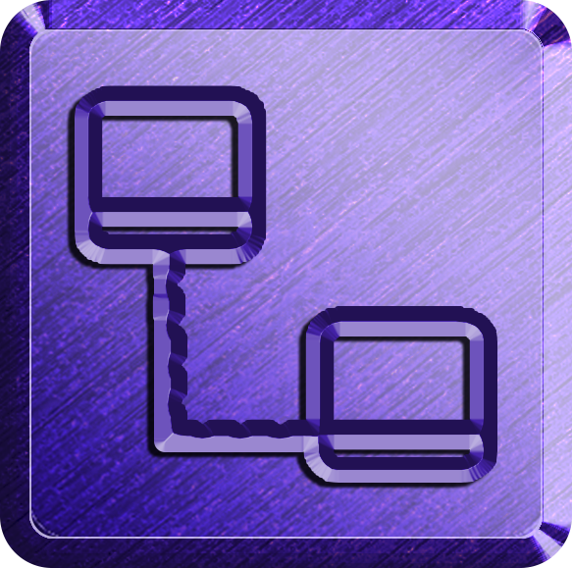
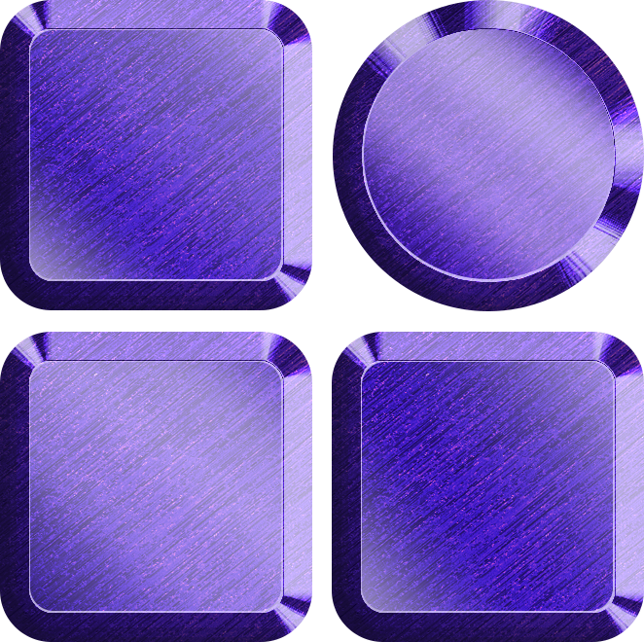



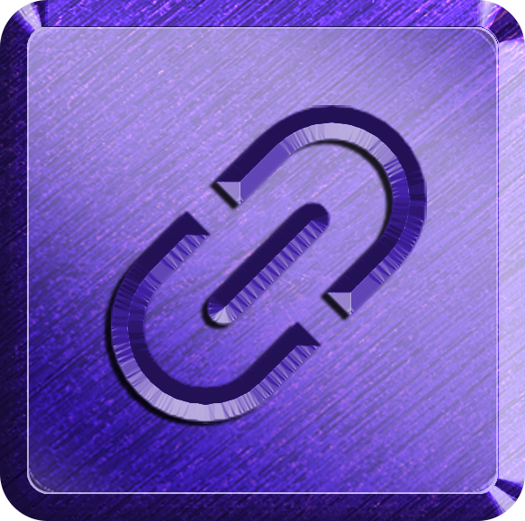

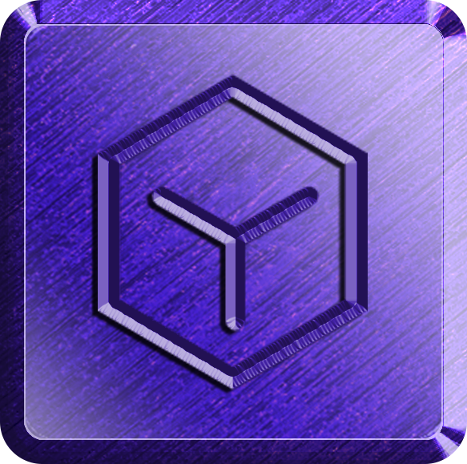
Incubation
App Store
Deployment
App Development
Services
MEAO
EdgeGallery Application Pipeline
Application
Packaging
Certification
App Store
MEPM
App Integration
Sandbox
Nodes
Application Incubation
Application Repository
Distribution and Deployment
Application Integration
Application Development

Slide 6
Incubation
App Store
Deployment
MEAO
Application Integration Pipeline
Application
Sandbox
Packaging
Certification
App Store
MEPM
Nodes
Application Incubation
Application Repository
Distribution and Deployment
Application Integration
Application Development

Slide 7
Incubation
App Store
Deployment
Services
MEAO
Application Development Pipeline
Application
Packaging
Certification
App Store
MEPM
Sandbox
Nodes
Application Incubation
Application Repository
Distribution and Deployment
Application Integration
Application Development

Slide 8

EdgeGallery: An Open Source MEC Implementation
Connection/management/application/ecosystem collaboration
App 1
App 2
App N
Easy integration,
Quick application rollout
UPF+MEP
Unified application integration management
LBO
VM
ULCL
NAT
container
DNS
Heterogeneous computing hardware platform
5G control plane
CloudOS
(Kunpeng, x86, GPU, and NPU)
Hardware
Open MEC platform
Central node

Slide 9
EdgeGallery: Building Blocks
Central Location
MECM
Developer Portal
App Store
MECM
MECM
Edges
Edges
Edges
MEP
MEP
MEP
Application Incubation
Application Repository
Multi-access Edge Compute Manager
Multi-access Edge Compute Platform

Slide 10
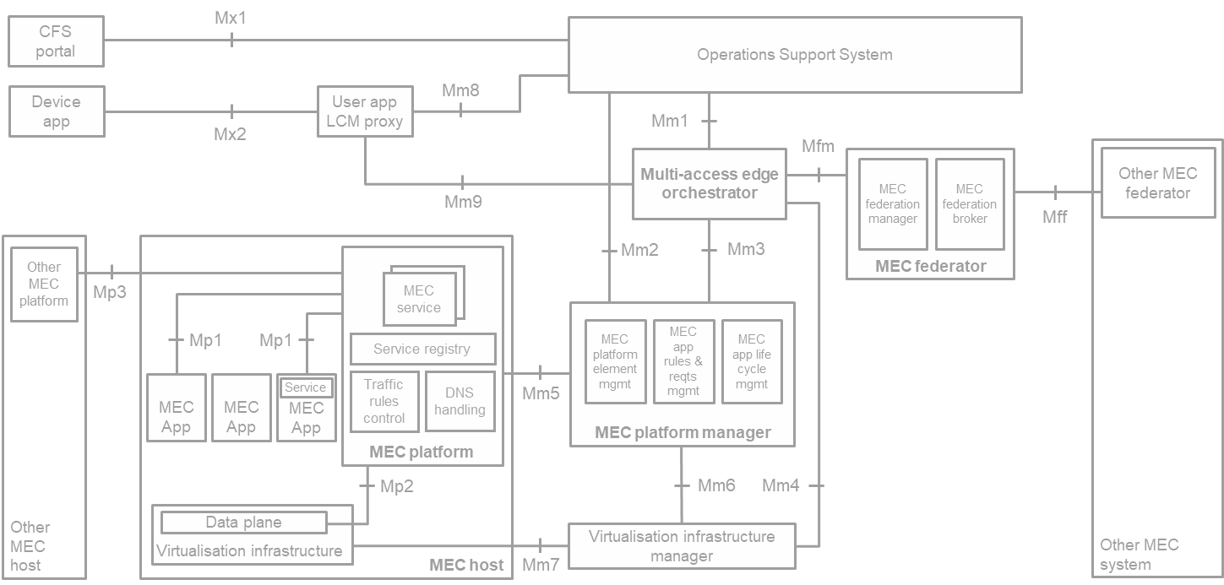
EdgeGallery: ETSI MEC Mapping
MEP
MECM
(MEAO + MEPM)
Multi-access Edge Compute Manager(MECM)
Multi-access Edge Compute Platform(MEP)

Slide 11

Application Design Stage
Application Distribution Stage
Application Running Stage
Public services
Developer Platform
Application Repository
Management Plane (Orchestrator)
MEP platform
Containerized Apps
VM Apps
Application Lifecycle Management
Application Image design
Application Distribution
App Orchestration
Application Agent
Application Agent
Application Rule Manager
Application Development Capability Design
Application Experience
Package Management
API Gateway
Application Package Design
Application Repository
App Rule Management
Container/VM orchestration
Security/Audit/Log/Load balancing/Monitoring
User Management
Security Workgroup Security
Integration Workgroup Integration
Open Capabilities
Data plane
Test Workgroup
Warehouse Interworking
Resource Management
EdgeGallery Architecture
Dashboard
SDK/API
Multiple network planes (Calico and Cilium)
API/Capability Repository
Pluggable Multicloud Management
Public cloud capability integration and openness
Local Open Capabilities (Hardware capability, 5G network capability, and third-party ecosystem capability)
Application Test Design
Image repository (remote/local)
Cloud Connector
DN/TSN
SR-IOV/...
Intent-Driven Policy Framework
Network Programmable Interface
Application Test Platform (ATP)
Infrastructure Management
Kubernetes/MicroK8S/K3S/Openstack...
Operating System
Centos/Ubuntu/OpenEuler/...
OS optimization (eBPF/XDP)
Heterogeneous hardware
X86, ARM, GPU, NIC/....
Public cloud/
Local development environment
Private cloud/
Enterprise DC
Edge node

Slide 12
Available
Future
Release v1.5
App Development Design Stage
Application Distribution Stage
Application Running Stage
Public Services
Developer Platform
Application Design
Platform
Application Repository
Management
Orchestration Platform
Edge Platform
Edge Autonomy/
User Self-Service
SDK/API/Plugin
Application Monetization (PoC)
Application Orchestration
Container/VM
WASM
Application
AppLCM
App Development Capability Design
Deployment Package Design
Application Distribution
Application Agent
AppRuleMgmt
Application Package Management
API Gateway
Container/Virtual Machine Packaging
Application Experience
Application Rule Management
SDK/API/Plugin
Container/Virtual Machine and WASM (PoC) orchestration
Security/Audit/Load Balancing
EdgeGallery Architecture
Application Package Design
Resource Management
External System Management 3rd / North Mgmt
Image Management
Online Debugging and Optimization
Application Repository
Open Capability
Data plane
User Management
Pluggable Multi-VIM Management
Remote Capability
Local Openness Capability
Multiple network planes (Calico and Cilium)
Sandbox/5G Environment
Warehouse Interworking
ETSI
Profile Management
Profile Design
API/Capability Repository
AI (Kunpeng)
5G NW Capability
DN/TSN
SR-IOV/...
Cloud Connector
Profile
(IOT...)
3rd party Capability Openness
Network Programmable Interface
Application Test Platform (ATP)
Intent-Driven Policy Framework
Infrastructure Management
Kubernetes/MicroK8S/K3S/Openstack...
Operating System
Centos/Ubuntu/OpenEuler/...
OS Optimization (eBPF/XDP)
Heterogeneous Hardware
X86, ARM, GPU, NIC/....
Public cloud/
Local development environment
Private cloud/
Enterprise DC
Edge node

Slide 13
Available
Future
Release v1.5
Platform Comp Deployment UI tool
Add new capability
App Development Design Stage
Creating application from existing capabilities with out code
Application Distribution Stage
Application Running Stage
Public Services
Developer Platform
Application Design
Platform
Application Repository
Management
Orchestration Platform
Edge Platform
Edge Autonomy/
User Self-Service
SDK/API/Plugin
Application Monetization (PoC)
Application Orchestration
Container/VM
WASM
Application
AppLCM
Webssh, image size reduction
Application Agent
AppRuleMgmt
App Development Capability Design
Deployment Package Design
Application Distribution
Application Package Management
API Gateway
Container/Virtual Machine Packaging
Application Experience
Application Rule Management
SDK/API/Plugin
Container/Virtual Machine and WASM (PoC) orchestration
Security/Audit/Load Balancing
EdgeGallery Architecture
Application Package Design
Billing: time & flavors
Resource Management
External System Management 3rd /North Mgmt
Image Management
Application Repository
Open Capability
Local Openness Capability
Data plane
User Management
Online Debugging and Optimization
Pluggable Multi-VIM Management
Remote Capability
ETSI
Multiple network planes (Calico and Cilium)
Added new one
Warehouse Interworking
AI (Kunpeng)
5G NW Capability
Sandbox/5G Environment
Profile Management
API/Capability Repository
Profile (IOT...)
Hardware Capability
DN/TSN
SR-IOV/...
Profile Design
Cloud Connector
Network Programmable Interface
Application Test Platform (ATP)
3rd party Capability Openness
Intent-Driven Policy Framework
Infrastructure Management
Kubernetes/MicroK8S/K3S/Openstack...
Operating System
Centos/Ubuntu/OpenEuler/...
OS Optimization (eBPF/XDP)
Heterogeneous Hardware
X86, ARM, GPU, NIC/....
Public cloud/
Local development environment
Private cloud/
Enterprise DC
Edge node

Slide 14
Application Design Stage
Application Distribution Stage
Application Running Stage
Public services
Developer Platform
Application Repository
Management Plane (Orchestrator)
MEP platform
Containerized Apps
VM Apps
Application Lifecycle Management
Application Image Design
Application Distribution
App Orchestration
Application Agent
Application Agent
Application Rule Manager
Application Development Capability Design
Application Experience
Package Management
API Gateway
Application Package Design
Application Repository
App Rule Management
Container/VM orchestration
Security/Audit/Log/Load balancing/Monitoring
User Management
Security Workgroup Security
Integration Workgroup Integration
Open Capabilities
Data plane
Test Workgroup
Warehouse Interworking
Resource Management
EdgeGallery Architecture
Dashboard
SDK/API
Multiple network planes (Calico and Cilium)
API/Capability Repository
Pluggable Multi-VIM Management
Public cloud capability integration and openness
Local Open Capabilities (Hardware capability, 5G network capability, and third-party ecosystem capability)
Application Test Design
Image repository (remote/local)
Cloud Connector
DN/TSN
SR-IOV/...
Intent-Driven Policy Framework
Network Programmable Interface
Application Test Platform (ATP)
Infrastructure Management
Kubernetes/MicroK8S/K3S/Openstack...
Operating System
Centos/Ubuntu/OpenEuler/...
OS optimization (eBPF/XDP)
Heterogeneous hardware
X86, ARM, GPU, NIC/....
Public cloud/
Local development environment
Private cloud/
Enterprise DC
Edge node

